Slide 1
RuntimeDroid: Restarting-Free Runtime Change Handling for Android Apps
Umar Farooq and Zhijia Zhao
University of California, Riverside
Android™ is a trademark of Google LLC.

Slide 2
What are “Runtime Changes”?
A few common Examples

Slide 3

Example
Runtime
Changes
Screen
Resize
Keyboard
De/attach
Orientation
Change
© Google Pixel
© Samsung Tab

Slide 4
Background: Standard Runtime Changes [1]
Change | Description
mcc/mnc | IMSI mobile country/network code
uiMode | User interface mode
keyboard | Keyboard type
keyboardHidden | Keyboard accessibility
locale | Language
fontScale | Font scaling factor
layoutDirection | Layout Direction i.e. RTL languages
orientation | Screen orientation
screenSize | Available screen size
smallestScreenSize | Physical screen size
touchscreen | Touch screen
Keyboards
Font/Lang
Screen
[1] Android Configuration API

Slide 5
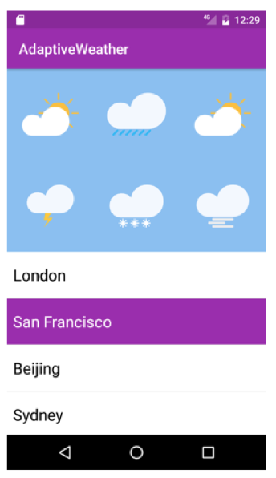
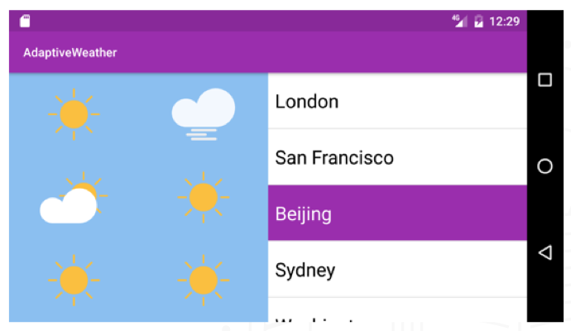
Background: Purpose of Runtime Change Handling
Allow an activity to load new resources for the new configuration
e.g. a different layout for landscape mode
An activity

Slide 6



Background: Default Handling
Activity restarts
go through all lifecycle stages
activity destroyed/recreated
Needs to save/restore activity data!! (e.g., game state, user input)
override saving/restoring callbacks
retain objects (Fragments or LiveData)
Developers often fail to identify the right data or save/restore incorrectly
App launch
onCreate()
onResume()
onStop()
Created
Started
Resumed
Paused
Stopped
Destroyed
onStart()
onPause()
onDestroy()

Slide 7
Background: Customized Handling
Manually load resources
set flags (manifest) to bypass restarting
override onConfigurationChanged()
Non-trivial; rarely used
resource complexity (16 types)
usage complexity (static vs. dynamic)
need to preserve user changes
App launch
onCreate()
onResume()
Created
Started
Resumed
Resumed
onStart()
onConfigurationChanged()

Slide 8
Example Runtime Change Issues
Use screen rotation as an example, but also apply to other types

Slide 9
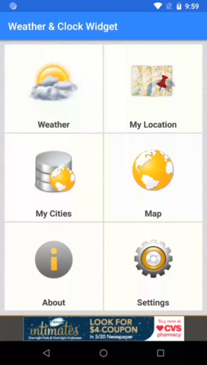

Example 1: Weather Data (Slowly) Reloaded
Runtime
Change
© Weather & Clock

Slide 10
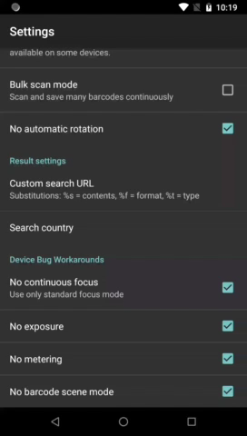
Example 2: User Input and Dialog Disappear
Runtime
Change
© Barcode Scan

Slide 11
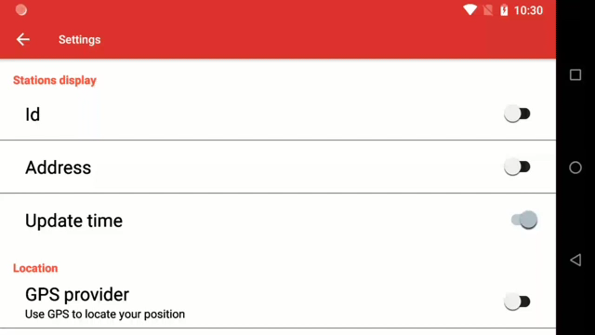
Example 3: Duplicated UIs
Runtime
Change
© Vlille Checker

Slide 12
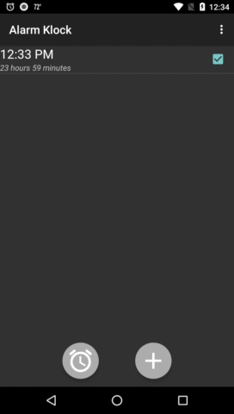
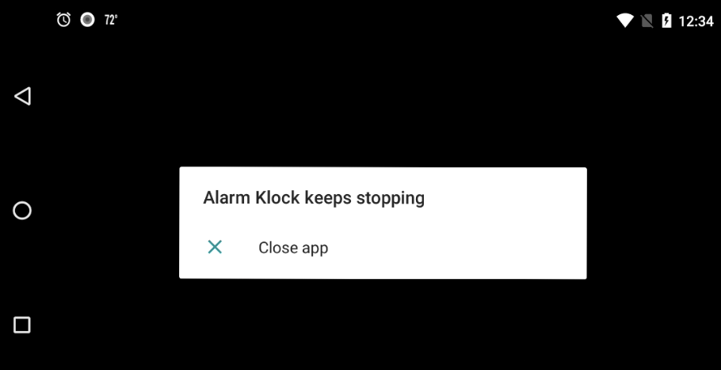
Example 4: The Whole App Crashes
Runtime
Change
© Alarm Klock

Slide 13
Rise of Runtime Change Issues
342/765 (45%) projects from Github have Runtime Change issues
Studies show [MobileHCI’15]
On average, Users change orientation every 5 minutes
Language change is often needed for multi-lingual users
Tablet users often de/attach the keyboard
Will be more frequent due to the new multi-window feature
Every time user drags the boundary, a runtime change will be triggered

Slide 14
This Work
A formative study of runtime change handling
A new solution: restarting-free runtime change handling

Slide 15
Formative Study
Q1 (Landscape)
How do developers handle Runtime changes?
What are the common practices?
Q2 (Common Issues & Causes)
What are basic types of Runtime issues?
Are there any common causes?

Slide 16
Study Settings
3,567 Android projects from Github (Corpus-L)
16,160 Activity instances, 24.7M SLoC
top 1% Android projects on Github (ranked by popularity)
72 Android Projects from Github (Corpus-S)
507 Activity Instances, 1.5M SLoC
Each project has at least one Runtime Change Issue
Implemented an automatic analysis tool (RuntimeAnalyzer)

Slide 17
Findings: Handling Adoption
Restarting Based Handling
Object Retaining | 2%
saveInstanceState | 8%
No Data Preservation | 90%
Customized Handling
Runtime Change Callback | 13%
No overriding | 87%

Slide 18
Findings: Issues and Causes
Issues | Causes
Poor Responsiveness
(significant delays during runtime changes)
blocking operations
Activity restarts
➔
(e.g., network, DB ops)
State Lost
(unable to recover previous state)
Activity restarts
➔
unsaved/unrestored activity state
UI Malfunctioning
(UI looks different than expected)
Activity restarts
➔
inappropriate UI handling
App Crash
( the whole app stops)
Activity restarts
➔
references to destroyed objects
Can we avoid restarting while still having resources updated ?

Slide 19

This Work
A formative study of runtime change handling
A new solution: restarting-free runtime change handling
HotR – automatic online resource loading
Dynamic view hierarchy migration – preserving user changes
Manual Resource
Updates
Restarting

Slide 20
HotR- Overview
Major components
Resource HashMap Construction
For easy resource accesses

Slide 21
HotR- Overview
Major components
Resource HashMap Construction
RH_{new}
Alternate Res. Identification
no
Runtime
Change
RH_{old}
stop
Any alternative resources (need to update) ?

Slide 22
HotR- Overview
Major components
Reversed HashMap Construction
RH_{new}
Alternate Res. Identification
no
Runtime
Change
RH_{old}
stop
yes
RH_{diff}
Resource Updating
Update w/ alterantive resources!

Slide 23
HotR- Overview
Major components
Where resources are used ?
Reversed HashMap Construction
RH_{new}
Alternate Res. Identification
no
Runtime
Change
RH_{old}
stop
yes
RH_{diff}
Resource Updating
Property Res. Mapping
M_{PR}
Prog.
Convention

Slide 24
HotR: An Example
TextView w/ string resource update during an orientation change

Slide 25
HotR: Resource Hashmap Construction
/res/values-port/res.xml
<string name="enter">Enter</string> <color name="yellow">0xffffff00</color>
/res/values-land/res.xml
<string name="enter">Enter Name</string> <color name="yellow">0xffffff00</color>
R object
R.string.enter = 134 R.color.yellow = 152
Old Resource Object
New Resource Object
Key | Value
Enter | 134
0xffffff00 | 152
Key | Value
Enter Name | 134
0xffffff00 | 152
Resource HashMap-port
Reversed!
Resource HashMap-land

Slide 26
HotR: Identifying Alternative Resource
Resource HashMap-old
Resource HashMap-new
Key | Value
Enter | 134
0xffffff00 | 152
Key | Value
Enter Name | 134
0xffffff00 | 152
Diff
Color Resource
Dimension Resource
Drawables
Alternative Res. Exists
String Resource
Key (old) | Value
Enter | 134
RH_{diff} = RH_{old} − RH_{new}

Slide 27
HotR: Updating Alternative Resource
/res/values-land/res.xml
<string name="enter">Enter Name</string> <color name="yellow">0xffffff00</color>
RH_{diff} = RH_{old} − RH_{new}
Key (old) | Value
Enter | 134
New Resource Object
134
“Enter”
txt = TextView_{old}.getText();
id = RTable.query(txt);
TextView_{new}.setText(id);
134
“Enter Name”

Slide 28
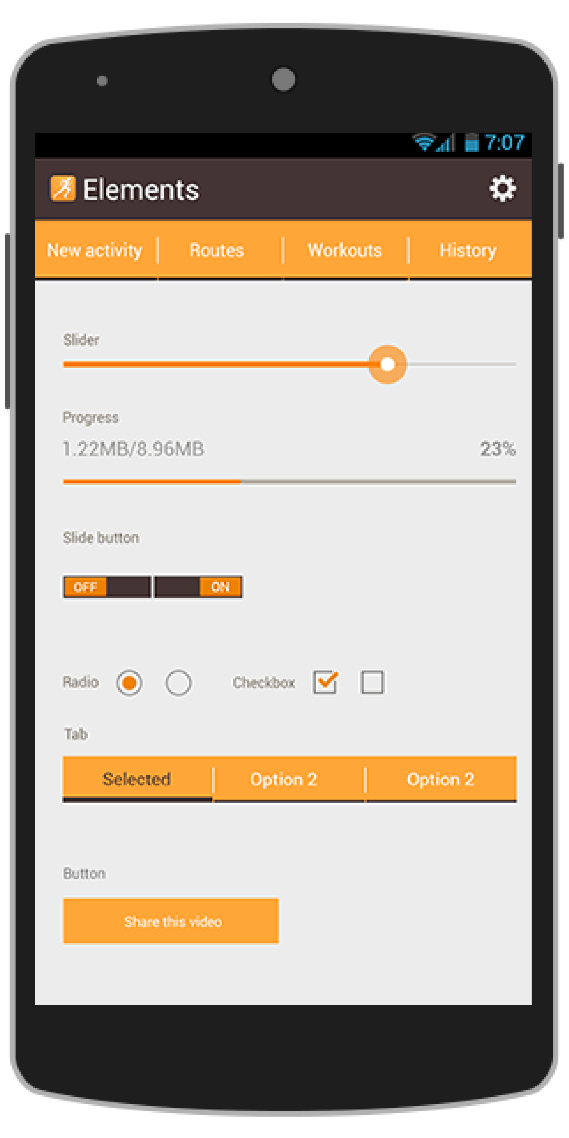
HotR: From One View to All Views

Slide 29
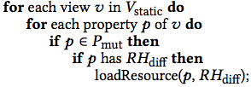
HotR: Traverse View Hierarchy
based on programming convention (e.g., string for ViewEdit.txt)
Root Element(R.id.content)
only care about mutable properties
Radio Group
TextView (text =“”)
Radio Item
Radio Item
E(text=@string/hello)
Activity View Hierarchy (Layout.xml)

Slide 30
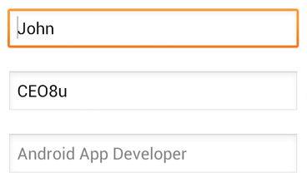
This Work
A formative study of runtime change handling
A new solution: restarting-free runtime change handling
HotR – automatic online resource loading
Dynamic view hierarchy migration – preserving user changes
<LinearLayout …>
…
<EditText …>
android:text = “@string EnterName”
…
</LinearLayout>
Override user inputs
New Resource

Slide 31
This Work
A formative study of runtime change handling
A new solution: restarting-free runtime change handling
HotR – automatic online resource loading
Dynamic view hierarchy migration – preserving user changes
<LinearLayout …>
…
<EditText …>
android:text = “@string EnterName”
…
</LinearLayout>
Override user inputs
New Resource

Slide 32
Dynamic View Hierarchy Migration
Ideas: migrate view properties from the old view hierarchy to the new
Derive
Old Static
View Hier.
Old Dynamic
View Hier.
New Static
View Hier.
New Dynamic
View Hier.
(oldLayout.xml)
(just before runtime change)
(newLayout.xml)
(just after runtime change)

Slide 33

Example: Dynamic View Hierarchy Migration
Root Element(R.id.content)
Root Element(R.id.content)
A
B (text =“”)
A
B (text =“hi”)
C
D
E
C
D
E
Old Static View Hierarchy (XML)
Old Dynamic View Hierarchy (Activity)
Root Element(R.id.content)
Root Element(R.id.content)
A
B (text =“hi”)
A
B (text =“”)
C
D
G
C
D
G
New Dynamic View Hierarchy (Activity)
New Static View Hierarchy (XML)

Slide 34
This Work
A formative study of runtime change handling
A new solution: restarting-free runtime change handling
HotR – automatic online resource loading
Dynamic view hierarchy migration – preserving user changes
Two practical implementations
RuntimeDroid-Plugin
RuntimeDroid-Patch

Slide 35
Implementation
Extends
AppActivity
Extends
Activity
RActivity
RActivity implements RuntimeDroid
App logic independent
Minimal code modifications
RuntimeDroid-Plugin | RuntimeDroid-Patch
Based on Android Studio & IntelliJ | Based on Soot
can fix to single activity or all activities | Applicable to executable (.apk)

Slide 36
This Work
A formative study of runtime change handling
A new solution: restarting-free runtime change handling
HotR – automatic online resource loading
Dynamic view hierarchy migration – preserving user changes
Two practical implementations
RuntimeDroid-Plugin
RuntimeDroid-Patch
An evaluation
Issue fixing
Handling delay reduction

Slide 37
Evaluation: Methodology
72 Android Projects from Github (Corpus-S)
507 Activity Instances, 1.5M SLoC
36 are available on Google Play
197 issues related to Runtime Change Handling (reported on Github)
Devices:
Nexus 5X (Android 8.0)
Macbook Pro (2.0 GHz, 8GB memory)

Slide 38
Evaluation: Results
Applicability:
503/507 activities are refactored
Only 4 activities failed
Library activities, when source not available for Plugin solution
NativeActivity, No Java code available (C++ code)
Issue Fixing:
197/197 issues fixed (manually verified)
Runtime change delay reduced by 9.5X on average

Slide 39
Takeaway
A large portion of Android apps suffer from runtime change issues
projected to be more common
Activity restarting is a major cause
RuntimeDroid: Restarting-Free Runtime Change Handling
easy to apply
fixed 197/197 runtime change issues
reduced delay by 9.5X on average

Slide 40
Thank you!
Questions

